Slide 1
Room 20 scholars
Grade 4

Slide 2
Good afternoon Brennan Rogers!!
We are the Room 20 Scholars and this afternoon we are going to share what is happening in our classroom!
Enjoy!!

Slide 3
CREW
In CREW, we are learning how to give firm, professional handshakes, and we are also wrapping up our crew target for this week: I can be a problem solver in and out of the classroom. Ms. Sendroff, our CREW partner, has been helping us out with this!

Slide 4
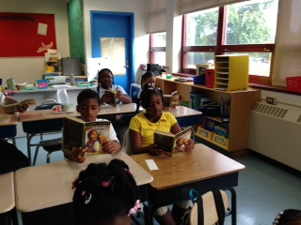
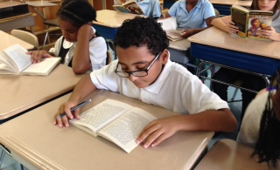
Readers Workshop/Plugged In
In reading, we are reviewing cause and effect as a part of Beginning It Great. In the past, we’ve reviewed some exciting reading strategies such as asking and answering questions while reading. We became detectives as we read! We also started our Plugged-In text, Yolanda’s Genius!

Slide 5
Science
In Science, we’ve been learning about Isaac Newton and motion. One of the most exciting parts of the unit so far is experimenting with Knex and building cars! We even have a song about it performed and composed by of our own!

Slide 6
Writing
In writing we have been reviewing sentence structure, punctuation, and paragraph writing. We have also been working on our spelling words.

Slide 7
Math
In math, we have reviewed addition, subtraction, and multiplication. We have a song about it composed performed by one of our own! →
This week, we are reviewing fractions. We actually just took our quiz!

Slide 8
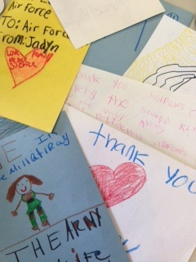
9/11 Letters
In honor of those who lost lives in the 9/11 tragedy, as well as those in the military who continue to serve our country everyday, room 20 has been writing letters to our nation’s heroes during dismissal.

Slide 9
☺
THANK YOU FOR WATCHING THE ROOM 20 SHOW!!!

